Slide 1
The Importance of Keeping Them Safe:
The Survivors and Children in Situations of Intimate
Partner Violence
Auckland University of Technology
May 22, 2017
Judge Eugene M. Hyman (Retired)

Slide 2
Presenters
Judge Eugene M. Hyman Judge of the Superior Court of California County of Santa Clara Judge Hyman served in various divisions within the Court from 1990 until his retirement in March 2011.
Rob Veale MNZM New Zealand Police (1977 – 2008) Manager : Violence Reduction Unit, PNHQ Family Violence Death Review Committee
Notes:
1

Slide 3
Session Outline
Part One (10 mins) | An outline development of risk assessment tools from an IPV perspective, and how these tools are used as the basis for safety planning from a community perspective.
Part Two (25 mins) | An outline opportunities for lawyers to consider risk assessment information and how this information may be used to enhance current practice including information sharing between different divisions of the Court.
Part Three (25 mins) | Open discussion session
Notes:
1

Slide 4
Domestic Violence - Overview
Usually not a specific statute but rather a general crime.
Involves power, control and coercion
Characterised by:
  Inter=generational dynamics
  Repeat victimisation (40% +)
  Gendered nature of violence
    Protection order applications
    Femicide – suicide dynamics
Strong correlation between IPV and CAN
  Where there is IPV there is a 70 chance of CAN (and vice versa)

Slide 5
Risk Assessment
Lethality Assessment
Risk Assessment
Safety Assessment

Slide 6
Definitions
Risk assessment is defined as …
“The formal application of instruments to assess the likelihood that intimate partner violence will be repeated and escalated. The term is synonymous with dangerousness assessment and encompasses lethality assessment, the use of instruments specifically developed to identify potentially lethal situations.”
Roehl & Guertin, 2000, p.171
Notes:
1

Slide 7
Benefits
The benefits in using risk assessment have been identified …
To assist women and domestic violence workers develop
more effective safety plans.
To assist perpetrator programmes to select the amount
and type of treatment.
To assist the criminal justice system to identify which
offenders need closer supervision.
As a tool for education service providers about domestic
violence.
By providing a shared language across a range of agencies.

Slide 8
Risk Markers
Table 1: Characteristics that increase the likelihood of re-assault.
History of assault | Stability of relationships
Motivation for treatment | Childhood abuse
Stability of employment | Attitudes to women
(Gondolf 2002)
Table 2: Indicative of life-threatening attack on a spouse include
Homicide/suicide threats | Homicide/suicide fantasies
Access to weapons | Displaying ‘ownership’
Displaying dependence | Being separated
Access to potential victims | Being depressed
Escalation of recklessness | Hostage taking
Victim having contacted law enforcement
(Pennsylvania Coalition Against Domestic Violence in Hilton, 1990)
Notes:
8

Slide 9
Risk Markers
Table 1: Characteristics that increase the likelihood of re-assault.
History of assault | Stability of relationships
Motivation for treatment | Childhood abuse
Stability of employment | Attitudes to women
(Gondolf 2002)
Table 2: Indicative of life-threatening attack on a spouse include
Homicide/suicide threats | Homicide/suicide fantasies
Access to weapons | Displaying ‘ownership’
Displaying dependence | Being separated
Access to potential victims | Being depressed
Escalation of recklessness | Hostage taking
Victim having contacted law enforcement
RISK IS NOT STATIC
NEEDS TO BE CONSIDERED
AT EACH PRESENTATION
(Pennsylvania Coalition Against Domestic Violence in Hilton, 1990)
Notes:
9

Slide 10
Risk Assessment Tools
Child, Youth and Family
When Child, Youth and Family receive a notification of concern for the
child/young person is received an assessment or investigation is undertaken. The Safety Assessment is designed to assist social workers in completing their safety assessment and response, by supporting social workers to consider the factors that may indicate the possibility of serious danger or harm for the child, or young person, and assists in providing a rationale for what action will be taken as a result.
Corrections (Probation) - (Out-of-Date)
The Department of Corrections (including Probation) use a model called RoC*RoI (Risk of re-Conviction X Risk of re Imprisonment). The RoC*RoI measure was developed for the New Zealand Department of Corrections to assist in the accurate prediction of an offender’s risk of conviction and likelihood of reimprisonment. It is based on static predictors (factors unchangeable by individual effort) from criminal history information.
Notes:
10

Slide 11
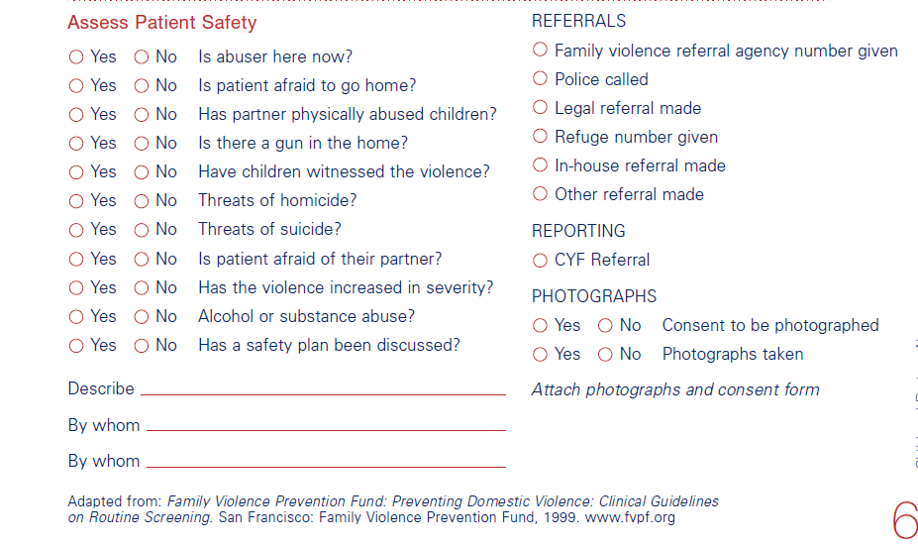
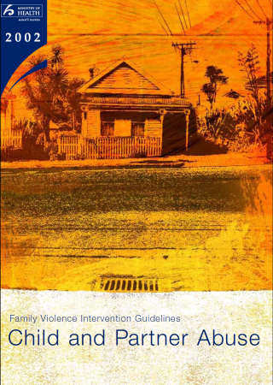
Risk Assessment Tools
Notes:
11

Slide 12
Old & New Police RA tools
Three Questions (for adult victims)
Provides the contextual background
Adapted from Queensland Police initiative
Twelve Red Flags
Risk markers for dangerousness adapted from numerous international examples
Ontario Domestic Assault Risk Assessment (ODARA)
Quantitative instrument (Canada)
Physical assault or threat with weapon
Notes:
1

Slide 13
Three Questions
How frequently and seriously does he or she intimidate, threaten or injure you or other family members?
Describe the most frightening event/worst incident of violence involving him or her?
How has his or her past behaviour impacted on you and your children's feelings of personal safety?
Notes:
1

Slide 14

Twelve Red Flags
The suspect is obsessed with, dependent on, or is stalking the victim.
Recent separation, issue of a court order, or divorce and behaving in a dangerous manner.
The victim believes the suspect could injure or kill them.
There is a history of family violence, and it is getting more severe or frequent.
Notes:
1

Slide 15
Twelve Red Flags
The suspect has strangled or attempted to strangle the victim.
The suspect has threatened to commit suicide or to kill the victim, children or other family members.
The suspect has access to weapons, particularly firearms and has used or threatened to use them. They may have convictions involving weapons.
The offender has easy access to the victim, children or other family members.
Notes:
1

Slide 16
Twelve Red Flags
Children are in the home when the violence occurred, or have been hurt or threatened in family violence situations.
Incidents of animal abuse.
History of alcohol or drug problems/dependency.
History of violent behaviour against non-family members.
Notes:
1

Slide 17
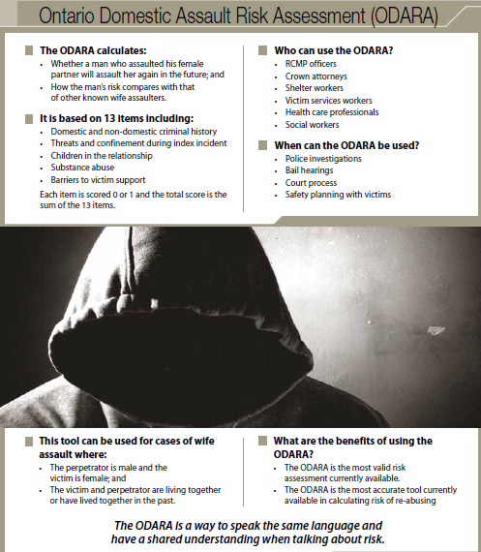
Notes:
1

Slide 18
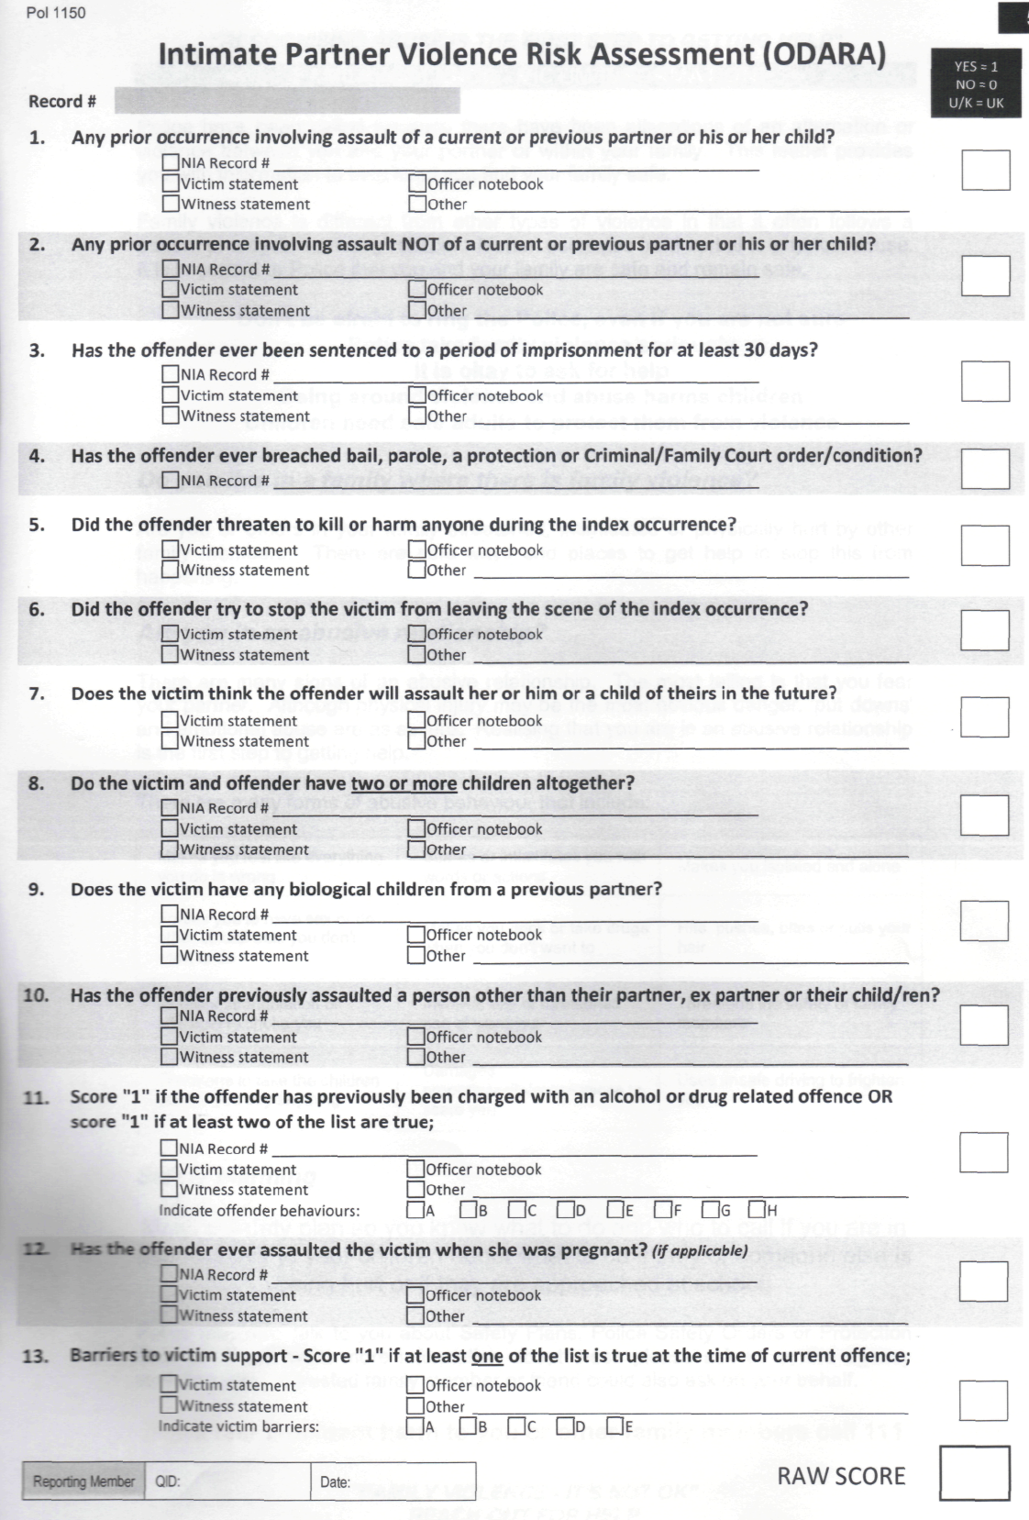
Notes:
1

Slide 19
Notes:
1

Slide 20
A Danger Assessment tool
Notes:
1

Slide 21
Part Two
Utilising and Sharing Risk Assessment Information
For the purposes of this discussion, reference will be made only to the Criminal and Family Court jurisdictions. This will also be limited to the sharing of risk assessment information.
Obviously there are many more opportunities for information sharing.
Notes:
1

Slide 22
Criminal Court Jurisdiction
Risk assessment in the context of bail
  Low risk options
  Higher risk requirement
Sentencing
  Probation conditions
    Amount of time in custody
    Programming conditions
  Judicial reviews
    Programmes
    Agency involvement, responsibilities
Notes:
1

Slide 23
Criminal Court Jurisdiction
Risk assessment in the context of bail
  Low risk options
  Higher risk requirement
Sentencing
  Probation conditions
    Amount of time in custody
    Programming conditions
  Judicial reviews
    Programmes
    Agency involvement, responsibilities
May inform PRE-SENTENCING
decisions re programmes, interventions
Notes:
1

Slide 24
Criminal Court Jurisdiction
Criminal information should be communicated to the Family Court. This may take place by:
Judges may take judicial notice
Lawyers may inform the Court of information in another Court
Notes:
1

Slide 25
Family Court Jurisdiction
Risk assessment in the context of:
  Child custody
    All custody decisions are based on the ‘best interest of the child’
    Rebuttable presumption re violent offenders
  Visitation
  Access
Risk assessment can inform safer decision making across three areas
Notes:
1

Slide 26
Family Court Jurisdiction
Information from Family Court that may be useful in the Criminal Court could include:
Statements made by the parties in custody evaluations
  Admissions made by the accused
  Impeachable statements made by the victim
Statements made in declarations in applications for an protection order
  Replies by the accused to statements in the affidavit
These statements potentially impact on risk assessment, safety planning and subsequent decision making.
Notes:
1

Slide 27
Wider Opportunities
Some wider opportunities for information sharing across jurisdictions could include:
Medical and forensic information relating to victims, the accused or children
Victim impacts statements
Substance abuse treatment assessments
Employment histories, skills and training
Character references
Other information
Each case will dictate what information can and should be shared.
Notes:
1

Slide 28
Therapeutic Courts
Therapeutic Courts are found in California (and other States) as a strategy to reduce substance abuse and other criminal behaviour.
In Family Courts they are used to assist parents be compliant with re-unification requirements in order to have children returned.
While there is evidence of their effectiveness in reducing substance offending, they appear less effective in reducing domestic violence.
Notes:
1

Slide 29
Questions & Discussion
Notes:
1

